Slide 1
Self-Supervised Generalisation with Meta Auxiliary Learning
Shikun Liu Andrew J. Davison Edward Johns
Notes:
Hello everyone. My name is Shikun Liu, a first year phd student at Dyson robotics lab.
I am honored to be here to present our work on meta and auxliary learning for Neurips 2019.
This is a joint work collaborated with andrew davison and ed johns.

Slide 2
Revisit Multi-task Learning
Multi-task learning
enforces multiple tasks to use the same set of feature space.
aims to improve generalization on every learning tasks.
Shared
Layers
Task A
Task B
Task C
Notes:
Before we step into any details of this research, let’s first refresh the definiation of multi-task learning.
MTL is learning paradigm, which let multiple tasks use the same set of the feature representation.
To do so, we hope we can improve generlisation on every learning tasks from the benefit of having additional useful information.

Slide 3
Revisit Auxiliary Learning
Auxiliary learning is similar to multi-task learning.
Only the performance of the primary task is of importance, and the auxiliary tasks are included purely to assist the learning of primary task.
Notes:
In some cases, instead of having a good performance on every task, we only care about the performance of one particular task.
So for this research, we foscus on the auxiliary learning.
So auxiliary learning is to split all of learning tasks into two parts: the primary task, the one we care about the performance, and the auxiliary task which are included only to assist the learning of the primary task.
As for the training phase, the multi-task learning and auxiliary learning can be considered as equal.

Slide 4
Rethinking Auxiliary Learning
Observation: For a given supervised task, some auxiliary tasks help more than others. Some may not help at all. (negative transfer)
Can the optimal auxiliary task be generated automatically?
Can this be done without access to additional data for this auxiliary task?
Notes:
However, intuitively, not all auxiliary tasks can be beneficial to the primary tasks. At least the amount of this helpfulness is different.
So it leads to our research interests: to answer those two questions:

Slide 5
Rethinking Auxiliary Learning
Observation: For a given supervised task, some auxiliary tasks help more than others. Some may not help at all. (negative transfer)
Can the optimal auxiliary task be generated automatically?
Can this be done without access to additional data for this auxiliary task?
Yes and yes — with Meta Auxiliary Learning!
Notes:
And the answer is yes and yes! Using our proposed meta auxiliary learning algorithm!

Slide 6
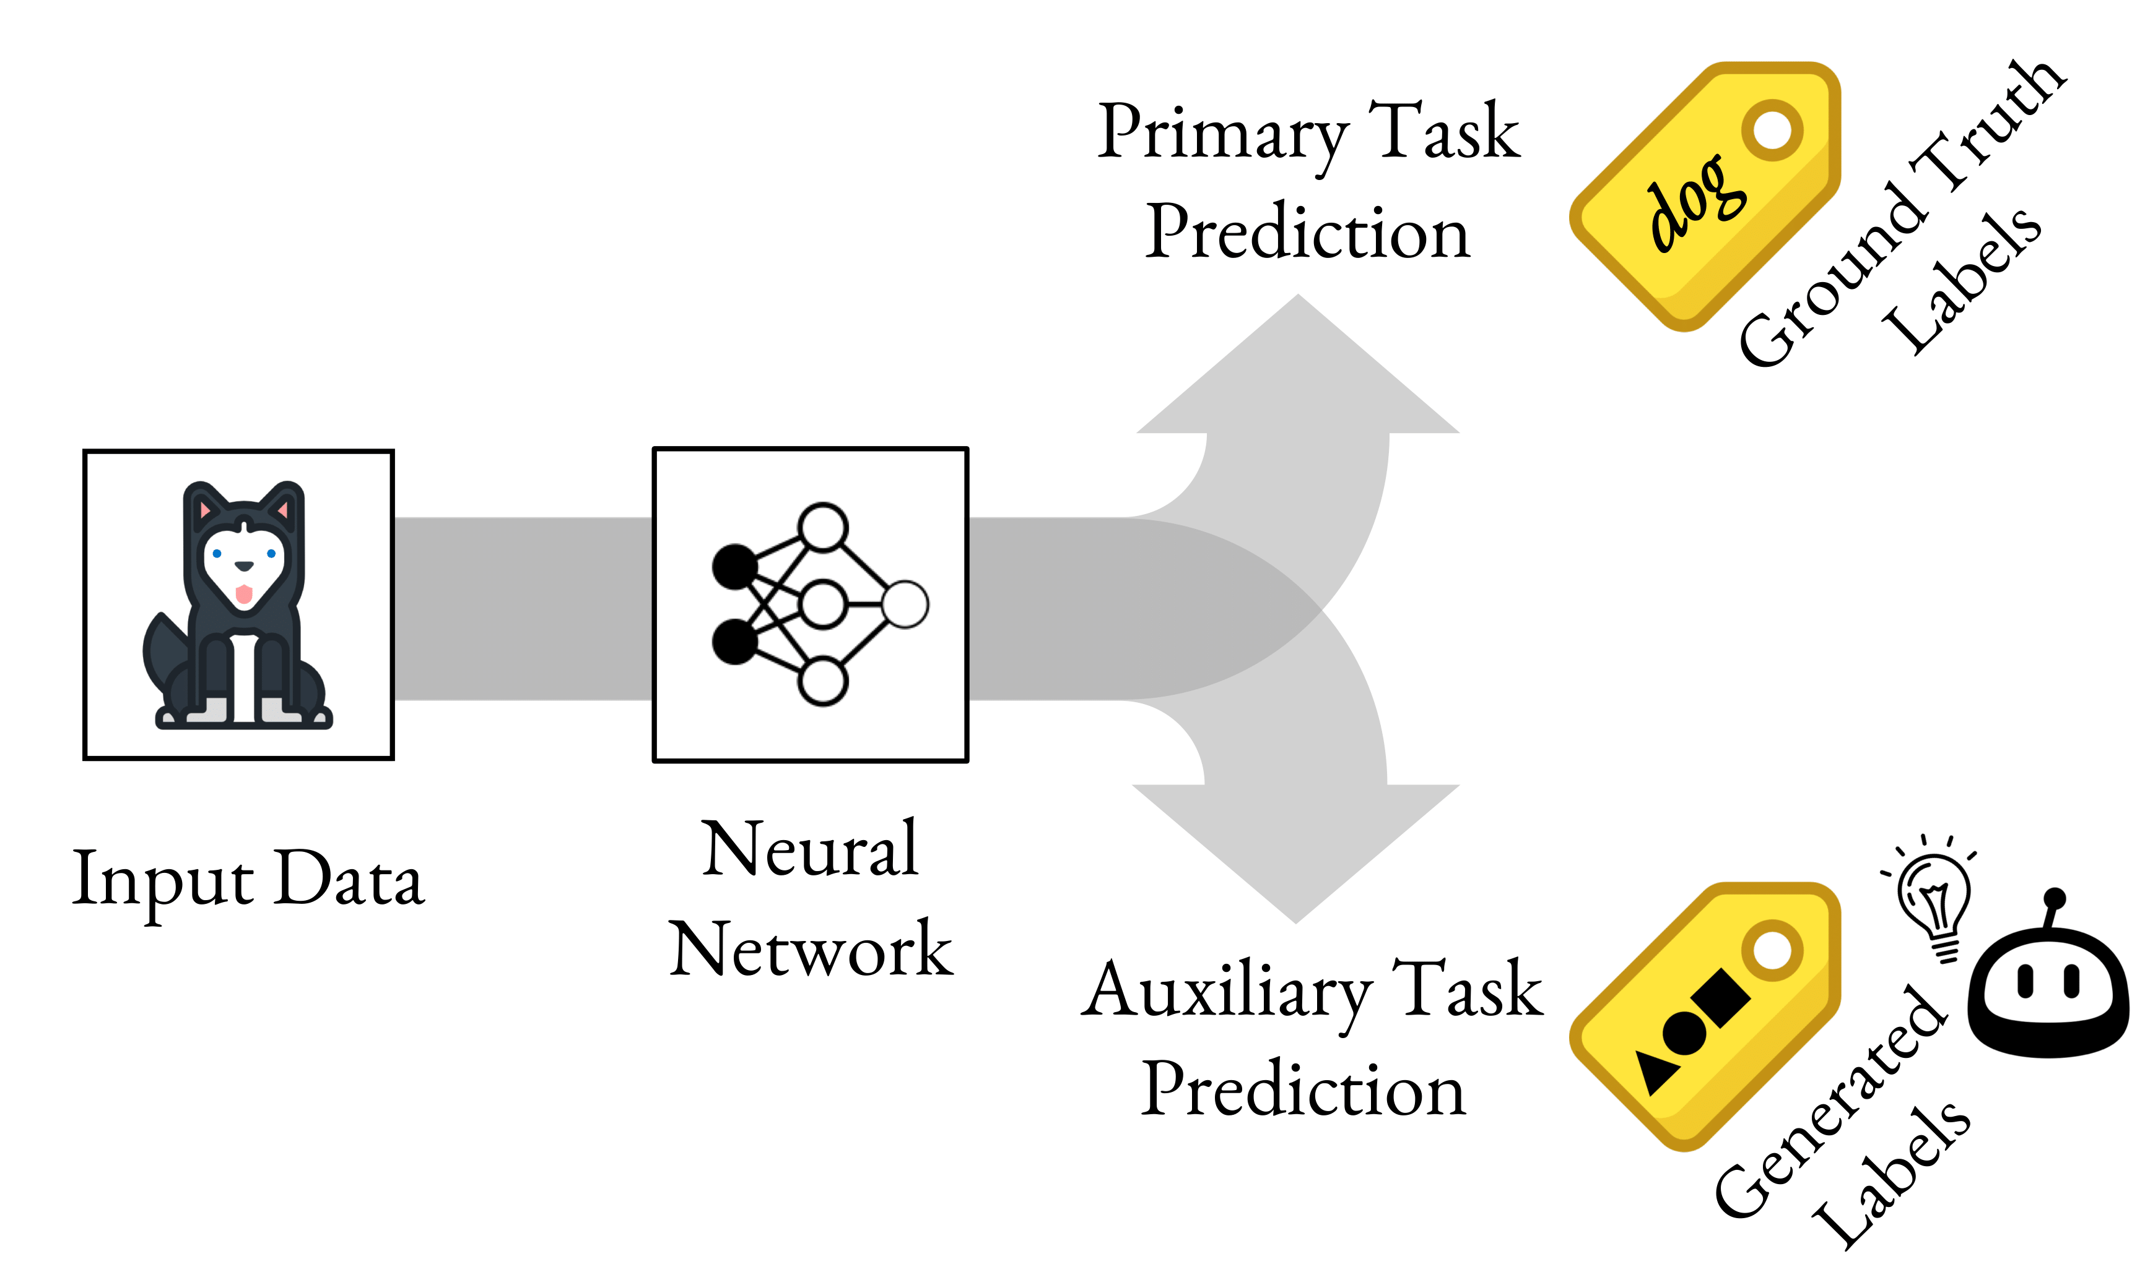
Meta Auxiliary Learning (MAXL)
MAXL is a framework which meta-learns optimal labels for an auxiliary task, to assist training of a given primary supervised task.
Notes:
So let me introduce meta auxiliary learning or MAXL.
As shown on the right hand side of this slide, MAXL is to generate labels for an auxiliary task which, when trained alongside with a primary task, learns a better representation and improve performance for the primary task.

Slide 7
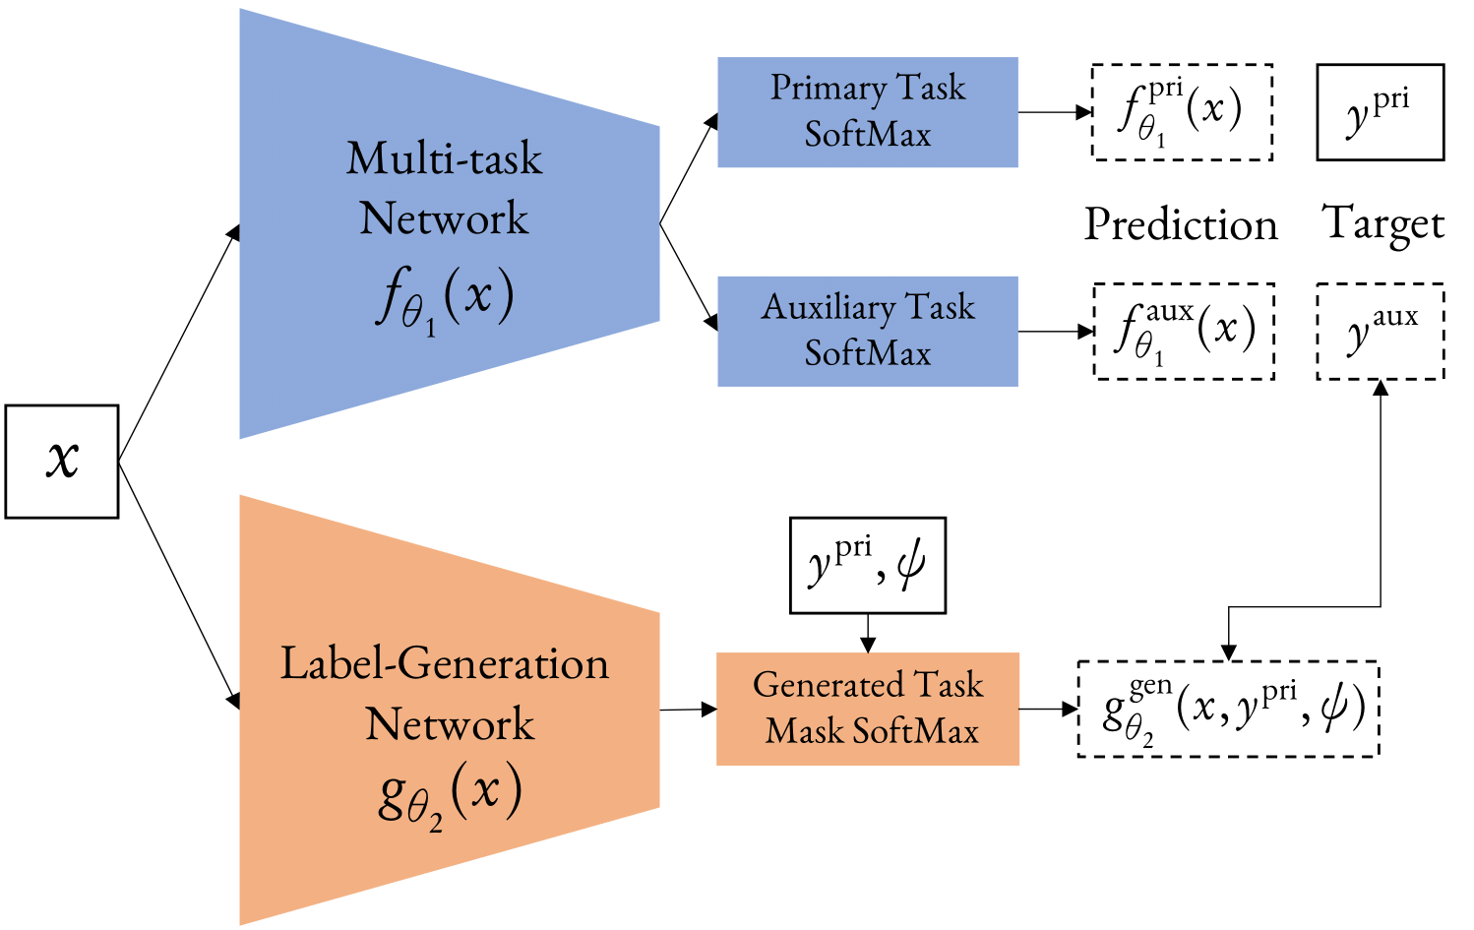
MAXL – Detailed Formation
Multi-task Network: trains on the primary task and auxiliary task in a standard multi-task learning setting.
Label-generation Network: generates the labels for the auxiliary task using meta learning.
A double gradient formulation encourages auxiliary labels which reduce the loss on the primary task.
Notes:
Let me explain this in more details. MAXL is consisted with two individual networks.
One is multi-task network, which trains on two tasks: one is primary task, which has the ground-truth primary task labels provided in the dataset.
another one is auxiliary task, whose labels are generated in label-generation labels below.
So just simply add those two losses together, as a standard multi-task learning setting., to update the network paramter theta_1 in propogation.
Label-generation network, as I explained before, it generates ground-truth auxiliary labels for the auxiliary task in the multi-task network.
To update the theta_2 is a little bit tricky.
So we want to let label-generation network to produce a good performance on primary task only.
So to update the theta_2 should only depend on the loss from the primary task. But primary task does not take anything from the label-generation network.
So instead of using standard back-prop, we apply double gradient using a retained computational graph of the updated theta_1, which we called theta_+ learned from the previous multi-task learning loss update.
This double gradient can be considered as a form of meta learning, so MAXL is learning to generate auxiliary labels to improve the performance of the primary task.

Slide 8
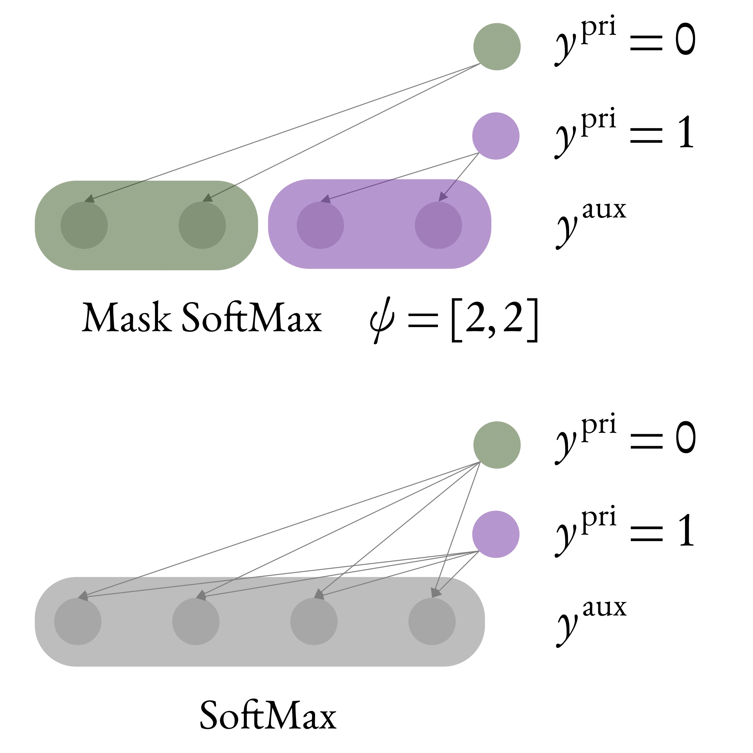
Mask SoftMax For Hierarchical predictions
Notes:
Another question in the label-generation network is how we can properly generate the auxiliary labels.?
As in this research, for simplicity, we consider learning tasks as image classification. So both primary and auxiliary task are image classification tasks.
From our previous research, we observed that a finer sub-hierarchy classification can be really helpful for a course label classification.
It’s quite intuitive since the finer labels contains more knowledge, if the network is able to classify well on finer labels, it the definitely classify well on the course labels.
So here we develop a strategy to help label-generation network to generate such hierarchy.
For which, we introduce an user-defined hyper-parameter called psi, representing the number of sub-classes for each primary class.
Then we apply a mask version of softmax to let the network produce auxiliary labels only in the a corresponding subset of a pre-defined auxiliary label space.
Here as an example, the psi is [2,2] which means the primary task is a binary classification. And the auxliary task is 2+2=4 class classification,
So for each primary task, we split it into two-sub-class classification, and label-generation network is learning to cluster the each input primary class into those meaningful two classes as a return to be helpful for the primary task.
For example as shown above, the primary task is binary task to classify the input image either a cat or dog, and label generation network is then to further sub-class the class into what type of dogs or cats to provide additional finer information for the primary task.

Slide 9
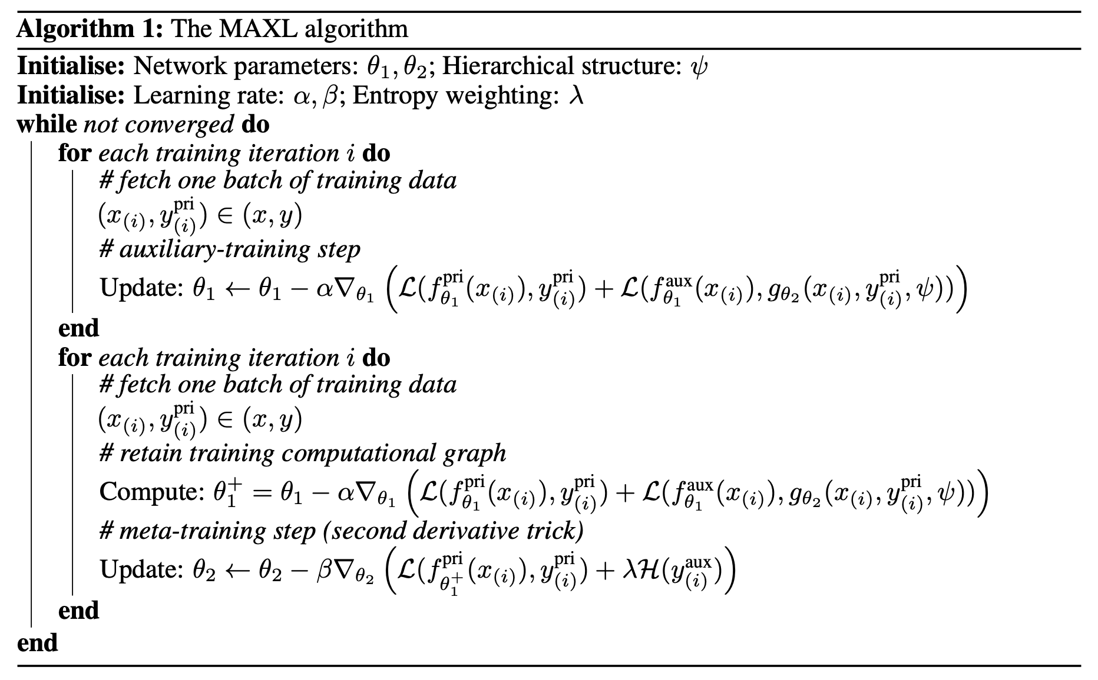
The MAXL Algorithm
Notes:
So to conclude, for this MAXL algorithm,
We first fix the label-generation network, and update the multi-task network by adding the losses for primary and auxliary task together.
And then we fix the multi-task network, to learning to produce a useful auxiliary labels by a user defined hierarchy using meta learning.
And train those two network in an iterative manner until they converge.

Slide 10
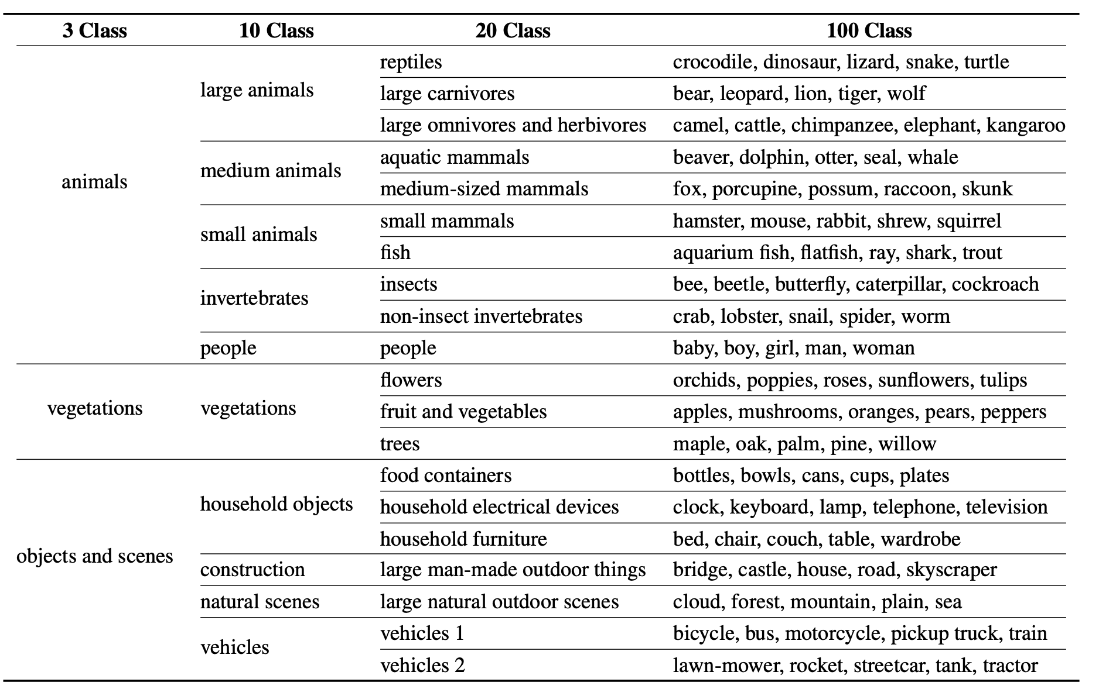
CIFAR-100 in 4-level Hierarchy
Notes:
And to evaluate the MAXL, we design a 4-class hierarchy dataset in based on CIFAR-100.
The most courest is 3-class classification as the input data is either an animal, or veg or objects.
The larger the number it goes, the finer the information it gives.

Slide 11
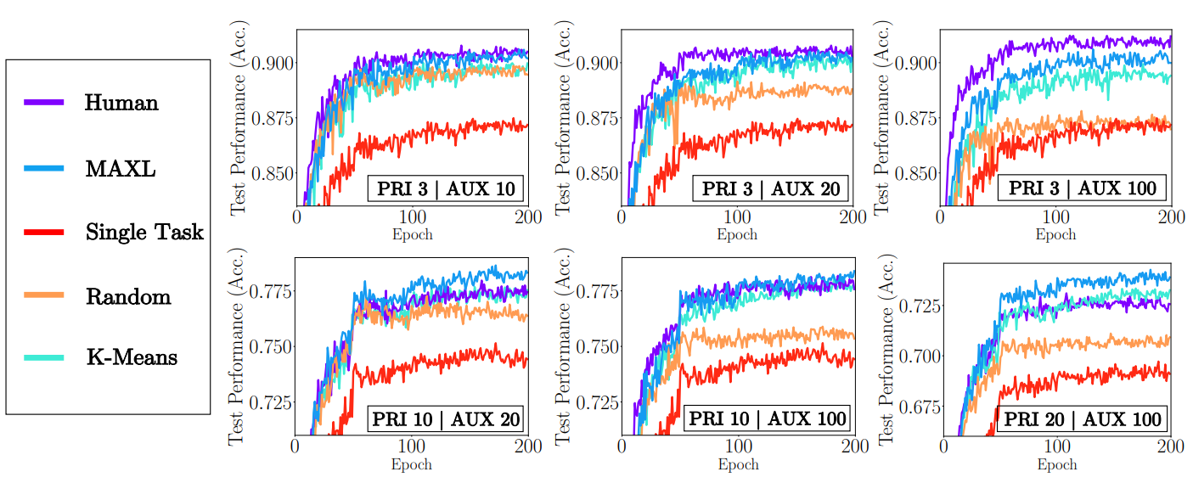
Compared to Auxiliary Learning Baselines
Notes:
We present the comparison of our MAXL with other baselines. The red curve having the lowest performance is single task learning.
And the rest 4 are auxlearning. So for all 6 possible combination of different hierarchies,
We can see the MAXL represented as in blue curve performs very close and sometimes better than the human-defined labels, as shown in purple.
We also show that it performs much better than the randomly genreated label, as in orange one (obviously), and similar to the one with K-means, in cyan color.
However, K-means require significantly longer training time as for unsupervised clustering. Our proposed MAXL can generate auxiliary labels on the fly.

Slide 12
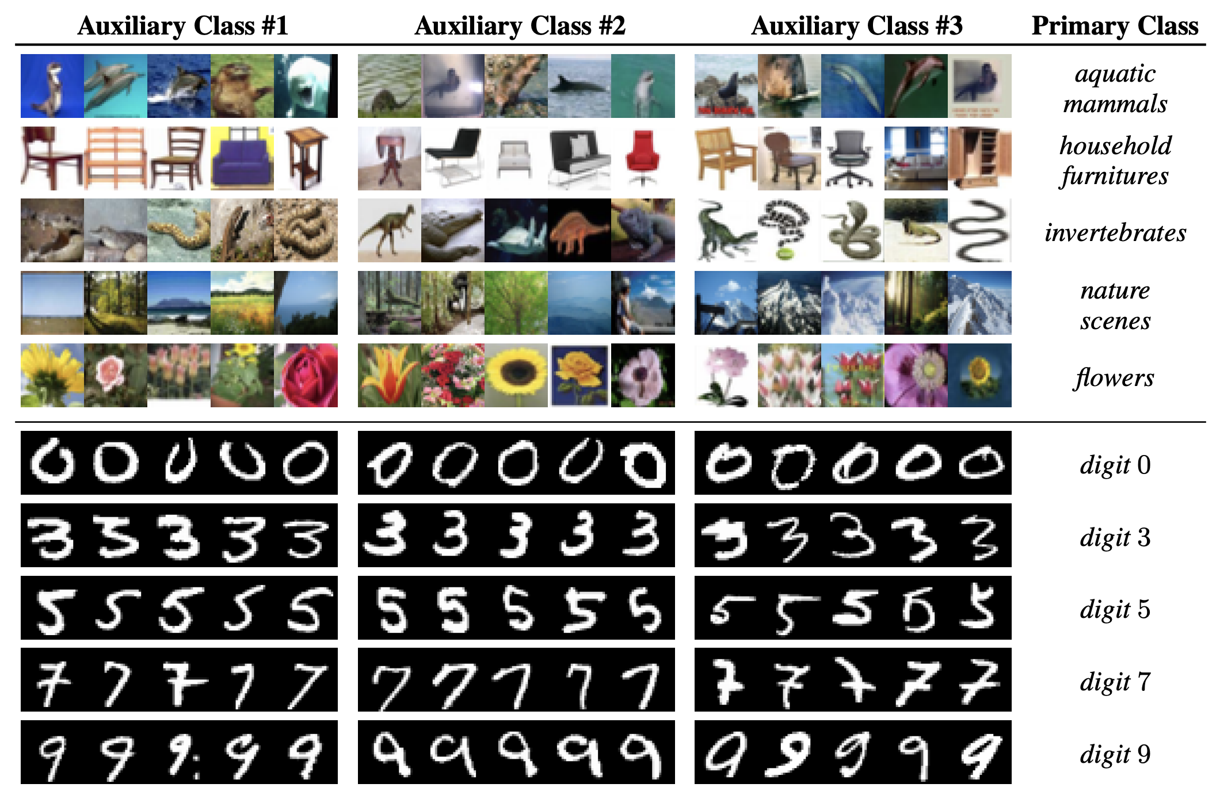
Visualisation of Generated LAbels
Notes:
Finally. The most interest part is to visualize the generated labels, like whether we can understand them.
So the upper part is from 4-hierarchy CIFAR-100, the primary task is 20-class classification and auxiliary task is then further split each primary class into 5 sub-classes.
The lower part is from MNIST which is the standard 10-class classification, and auxiliary task is then further split each primary class into 3 sub-classes.
Interestingly, even though the CIFAR part seems random, probably due to its high complexity, but for the MNIST part, some clustering is really interpretable.

Slide 13
Conclusions & future Works
MAXL: a learning framework to generate optimal auxiliary labels which, trained alongside with a primary task in a multi-task setup, improve the performance of the primary task.
MAXL 2.0:
  Learn generic auxiliary tasks beyond sub-class classification.
  Predict arbitrary vectors via regression.

Slide 14
Thanks for listening!

