Slide 1
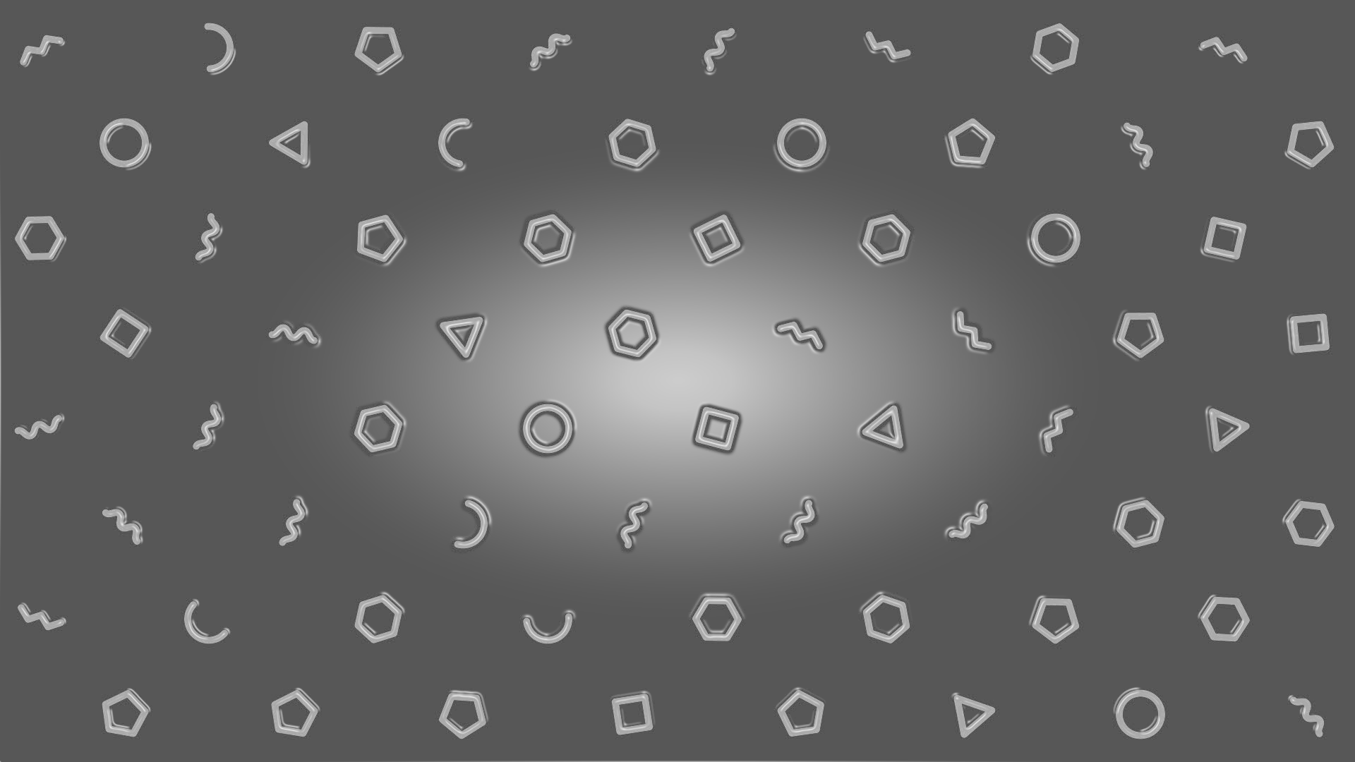
Shape Adaptor:
A Learnable Resizing Module
Shikun Liu¹, Zhe Lin², Yilin Wang², Jianming Zhang², Federico Perazzi², and Edward Johns¹
1
2
Notes:
Introducing shape adaptor, a learnable resizing module for neural networks.
This is a joint work collaborated with imperial college London and adobe research.

Slide 2
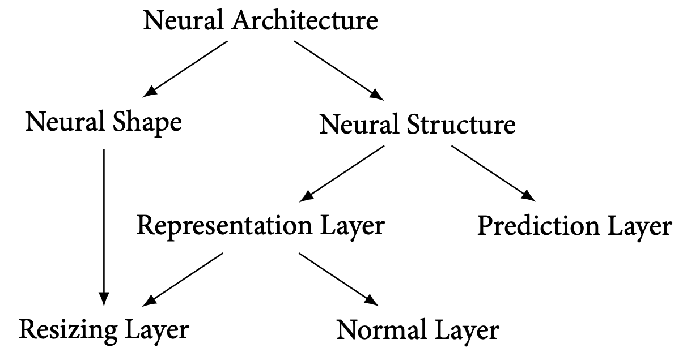
Design elements in a neural network
Our approach
NAS / AutoML
(Max-pool, stride-2 convolution)
(identity-layer, stride-1 convolution)
Notes:
A typical neural architecture is consisted with these two types of learning modules:
A normal layer, such as stride-1 convolution or identity mapping, and
A resizing layer, such as max/average pooling or stride-2 convolution.
The representation functions defined in these learning module define the network structure,
And the composition of reshaping factors in resizing layers define the network shape.
Previous AutoML or NAS systems focus on learning the right neural structure,
while in our paper, we emphasize that the neural shape is also an important design bias which should be optimized automatically.

Slide 3
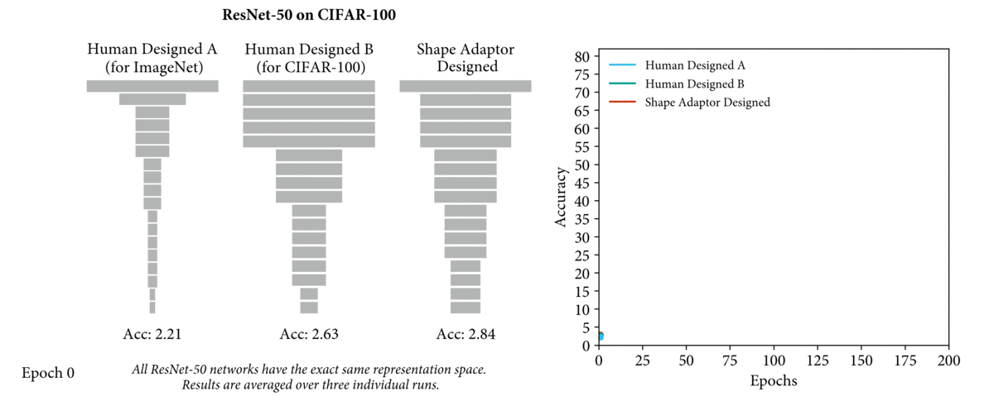
Neural shape is an import inductive bias!
Notes:
In the following animation, we show that
A ResNet-50 designed for ImageNet could achieve significantly worse results on CIFAR-100, compared to
A Resnet-50 specifically designed for the CIFAR-100 dataset.
This performance can be further improved with network shape designed automatically by shape adaptors

Slide 4
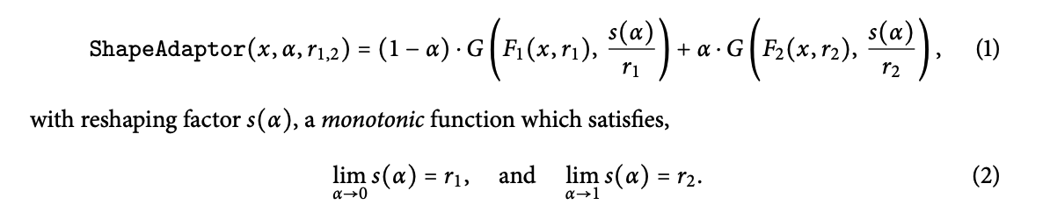
Design of shape adaptor
Adaptive
Resizing
Layer
with
weighted by
Adaptive
Resizing
Layer
with
weighted by
Resized
Features
Input
Features
Shape Adaptor
Notes:
A shape adaptor takes in an input feature, and reshapes it into two intermediate features.
Where each reshaping operator has a different, fixed reshaping factor, which defines a search space for our module.
These intermediate features are then reshaped back to the same dimension with a learned reshaping factor, corresponding to the scaling weight for each resized feature.
This scaling weight alpha is the only parameter introduced in a shape adaptor module, and so by simply optimizing these scaling weights, the entire network is differentiable,
and we may learn network shape in end-to-end manner.

Slide 5
Design of shape adaptor
Notes:
A shape adaptor takes in an input feature, and reshapes it into two intermediate features.
Where each reshaping operator has a different, fixed reshaping factor, which defines a search space for our module.
These intermediate features are then reshaped back to the same dimension with a learned reshaping factor, corresponding to the scaling weight for each resized feature.
This scaling weight alpha is the only parameter introduced in a shape adaptor module, and so by simply optimizing these scaling weights, the entire network is differentiable,
and we may learn network shape in end-to-end manner.

Slide 6
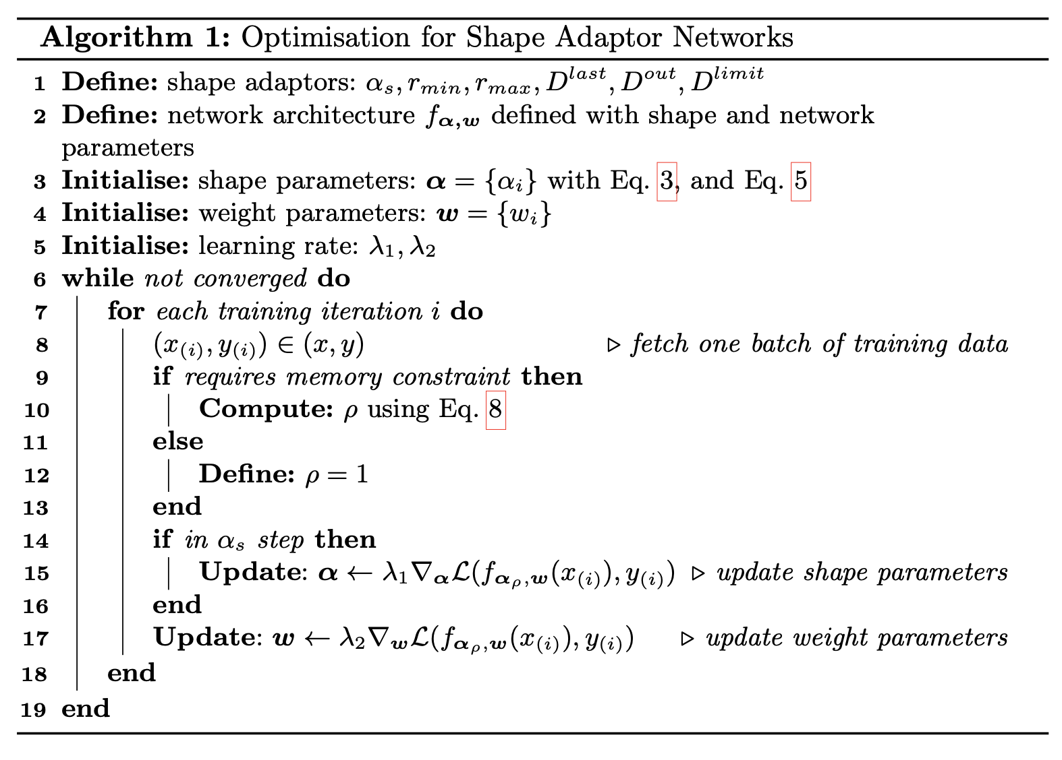
Optimisation of shape adaptor networks
Notes:
To optimize a neural network equipped with shape adaptor modules,
there are two sets of parameters to learn: the weight parameters, and the shape parameters.
Unlike NAS algorithms which require optimisation of network weights and structure parameters on separate datasets,
shape adaptors are optimised on the same dataset and require no re-training.
Since the parameter space for the network shape is significantly smaller than the network weight,
we update the shape parameters less frequently than the weight parameters, at a rate of once every α_s steps.
We also introduce a memory penalty rou during training, dynamically updated to compress the reshaping factors in shape adaptors,
This is to make sure, the memory cost of this network will be no greater than a pre-defined memory limit.

Slide 7
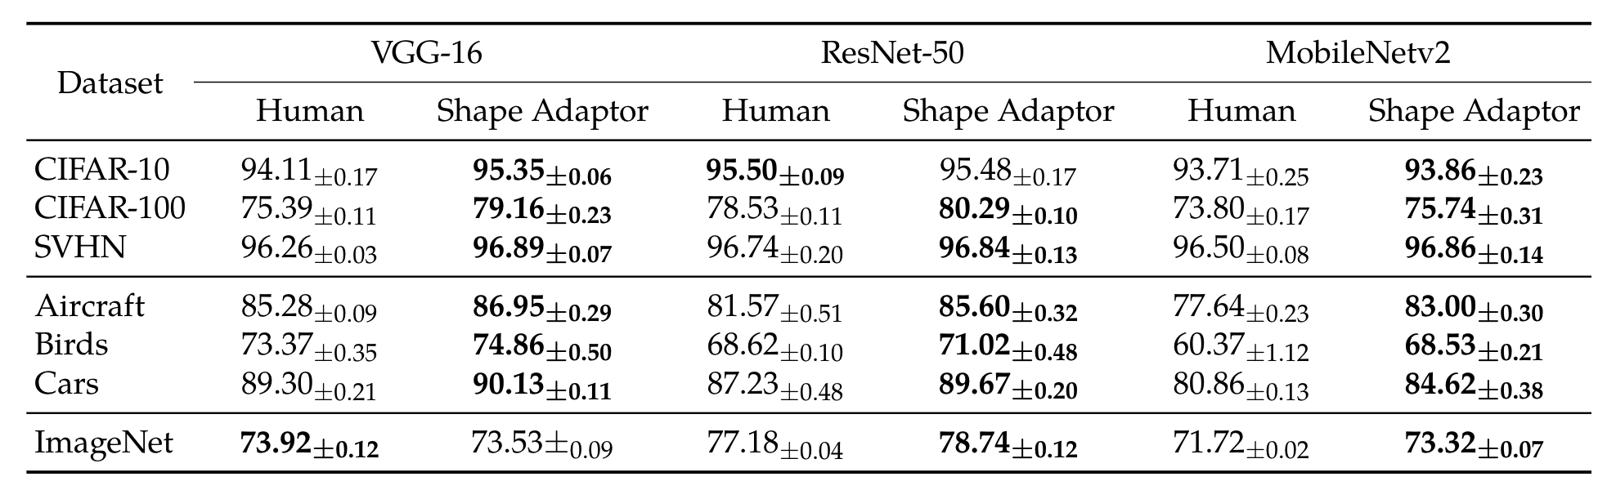
Results on image classification tasks
Notes:
We first evaluated shape adaptors on 7 image classification datasets with 3 different backbone architectures, to fully test its generality.
Our results show that shape adaptors can consistently improve human-designed networks, despite using the exact same parameter space.
We define the memory constraint as the current running GPU memory, so in this case, shape adaptors are applied to achieve optimal performance, without a hard memory limit.
However, shape adaptors can also be designed in memory-efficient way which we will introduce in the future slide.

Slide 8
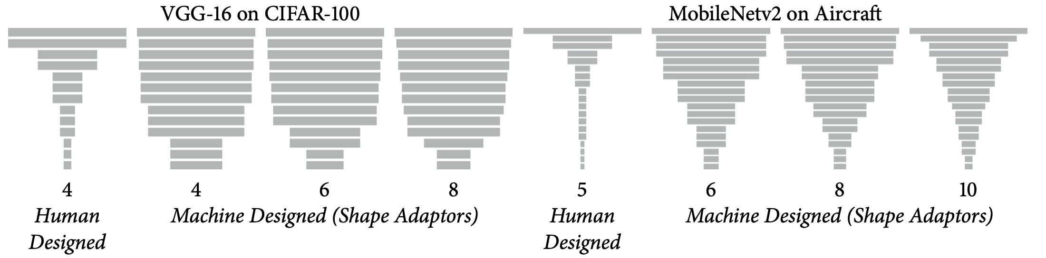
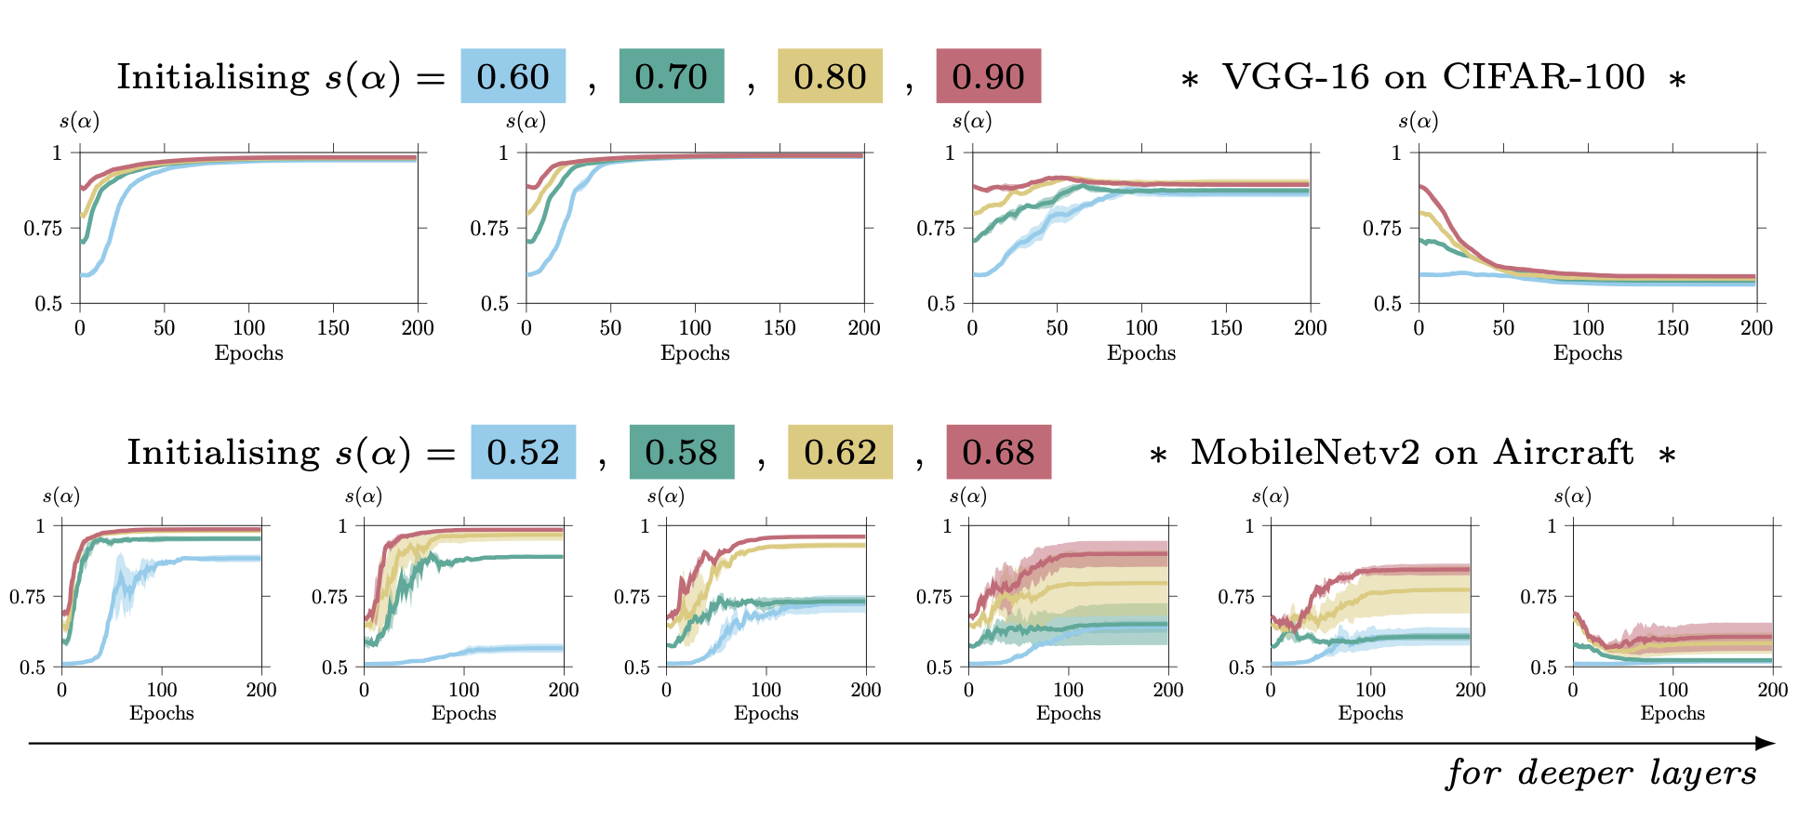
Shape adaptors are robust
Notes:
We then performed an ablative analysis on CIFAR-100 and Aircraft dataset, to understand the behavior of shape adaptors with respect to the number of shape adaptor modules, and shape adaptor initializations.
Results show that, shape adaptors are very robust to different initializations and the number of modules.
We found out that no matter how many different shape adaptors modules applied in the network, or choosing which set of initialisations, they typically converge to a similar task-specific shape, and with a similar trend of reshaping factors.
This shows stability and robustness of our method without needing the domain knowledge that is required for human-designed networks.

Slide 9
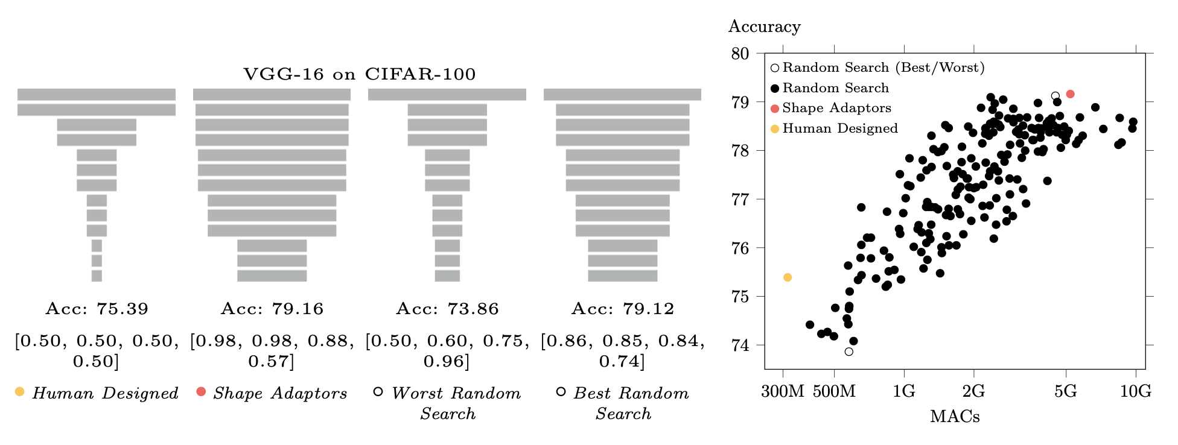
A study on neural shape learning
Human-designed neural shape is typically under-sized.
A good set of reshaping factors are generally arranged from large to small (in deeper layer of the network).
A wider neural shape would not guarantee an improved performance.
Notes:
We further performed a study on neural shape learning, to understand how network performance is correlated to different network shapes.
To achieve that, we ran a large-scale experiment by training 200 VGG-16 networks with randomly generated shapes.
We provide the visualisation of the randomly generated network shapes with the best and the worst performance, and compare them to the network shapes in human designed and shape adaptor networks.
First, Human-designed neural shape is typically under-sized. We can see that the best randomly searched shape obtains a very similar performance as well as a similar structure of shape compared to the ones learned from shape adaptors.
Second, the reshaping factors in the worst searched shape are arranged from small to large, which is the direct opposite trend to the reshaping factors typically learned by our shape adaptors.
Third, Just by increasing network memory cost is not able to guarantee an improved performance.
Finally, we can see a clear correlation between memory cost and performance, where a higher memory cost typically increases performance. However, this correlation ceases after 5G of memory consumption, after which point we see no improved performance. Interestingly, the memory cost of shape adaptors lies just on the edge of this point, which again shows the shape adaptor’s ability to learn optimal design.

Slide 10
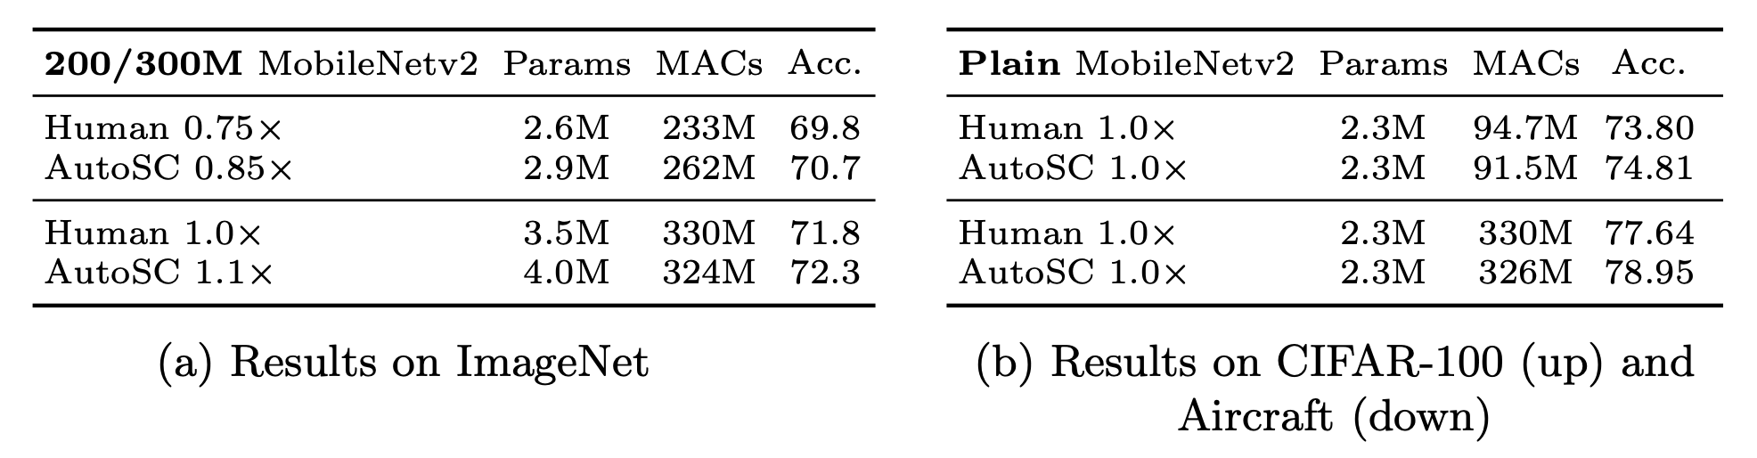
More applications:
Automated Shape Compression (AutoSC)
Attach down-sampling shape adaptors on human-designed networks without removing the original resizing layers.
Initialize shape adaptors so that the network shape is identical (r = 1) to the human-designed architecture.
Notes:
In previous sections, we have shown that shape adaptors are able to improve performance by finding the optimal network shapes, but with a cost of a huge memory requirement of the learned network.
In AutoSC, we show that shape adaptors can also achieve strong results, when automatically finding optimal memory-bounded network shapes based on an initial human design.
Instead of the original implementation of shape adaptors where these are assumed to be the only resizing layers in the network, with AutoSC we attach down-sampling shape adaptors only on top of the non-resized layers of the human-designed architecture, at the same time keeping the original human-designed resizing layers unchanged. We initialise shape adaptors so that the network shape is identical to the human- designed architecture, and thus the down-sampling shape adaptors can only learn to compress the network shape.
In all three datasets we evaluated on mobilenetv2, we can observe that shape adaptors are able to improve performance, despite having similar memory consumption compared to human-designed networks.

Slide 11
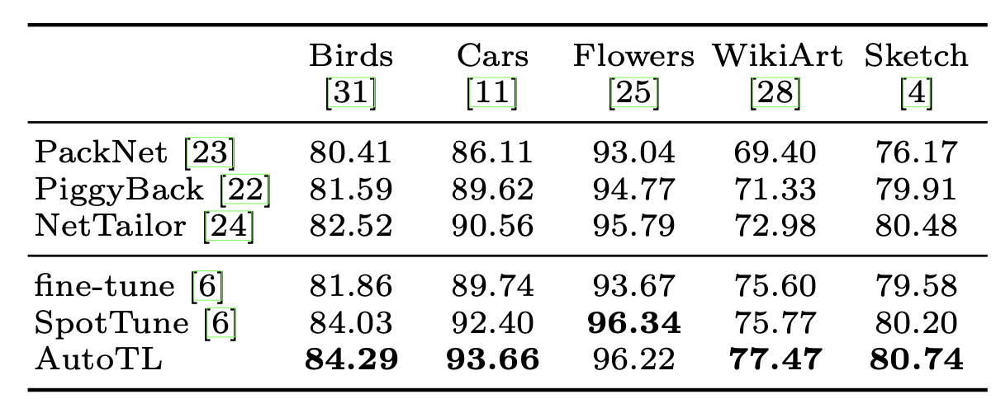
More applications:
Automated Transfer Learning (AutoTL)
Replace resizing layers with shape adaptors in a pre-trained network.
Initialize shape adaptors to have the same resizing factor defined in the original human-designed resizing layers.
Fine-tuning both network weights and network shapes.
Notes:
Finally, we present shape adaptor can also be designed to improve transfer learning, which we called automated transfer learning (AutoTL).
In AutoTL, we directly replace the original human-designed resizing layers with shape adaptors, and initialise them with the reshaping factors designed in the original human-defined architecture, to match the spatial dimension of each pre-trained network layer. During fine-tuning, the network is then fine-tuning with network weights along with network shapes, thus improving upon the standard fine-tuning in a more flexible manner.
The results for AutoTL have shown to achieve state-of-the-art performance as presented in this table.
We design AutoTL with standard fine-tuning, as the simplest setting to show the effectiveness of shape adaptors. In practise, AutoTL can be further improved, and integrated into other efficient transfer learning techniques.

Slide 12
Conclusion & Future works
Shape Adaptor: a general-purpose, learnable reshaping operator.
  achieve optimal performance with a given network structure.
  achieve optimal performance with a memory-bounded network architecture.
Even more interesting applications?
  Combined with NAS to learn optimal neural structure and shape in a unified manner.
  Combined with multi-task learning to learn task-specific neural shapes.
Notes:
For conclusion,
we presented shape adaptor, a learnable resizing module to enhance existing neural networks with task-specific network shapes.
With shape adaptors, the learned network shapes can further improve performances compared to human-designed architectures, without requiring an increase in parameter space. We may implement shape adaptors, aiming for different use cases:
It can be designed to achieve optimal performance, without having a memory limit,
or we may design memory-efficient shape adaptors, to learn optimal network shape within a human-defined memory bound.
For future work,
We plan to combine shape adaptors with NAS methods, so we may learn optimal neural shape and structure in a unifed manner.
We also expect shape adaptors can work well in a multi-task learning setting, which task-specific network shapes can be learned jointly with task-shared network weights in a single architecture.
To hear more, please come to our session; and check out the details in the original paper.

